Slide 1
Diabetes Prediction
IS 517 methods of data science
Final Project presentation
Mrunal Ghadge, Shabeeha Ahmed,
Yashashri Haryan

Slide 2
Problem Domain and its importance
Application:
Diabetes is most prevalent chronic diseases in the United States, impacting millions.
Our models can be used in healthcare system to predict if a patient can get diabetes with little information
People can understand the parameters that affect diabetes and can accordingly take actions
Why is the problem important?
Diabetes can lead to reduced life expectancy and quality of life
It can help the doctors in initial screening of diabetes
Benefitting audience:
Healthcare professionals for an initial screening
Common man to understand the parameters causing diabetes

Slide 3
Dataset
Dataset from Kaggle- “Diabetes Health Indicators Dataset”
3 different csv files
Initially, we planned to use Dataset 1.
Now we are using Dataset 2.
Dataset 1 :
253,680 observations
Predictor variable has 3 classes as 0, 1 or 2 (no diabetes, prediabetes, diabetes)
Dataset 2 :
70, 692 observations
50-50 split for predictor variable
50% of predictor variable has value 0 (no diabetes) other 50% has 1 (prediabetes or diabetes)

Slide 4
Dataset
Diabetes_binary
HighBP
HighChol
CholCheck
BMI
Smoker
Stroke
HeartDiseaseorAttack
PhysActivity
Fruits
Numerical
Veggies
HvyAlcoholConsump
AnyHealthcare
NoDocbcCost
GenHlth
Categorical
MentHlth
PhysHlth
DiffWalk
Sex
Age
Education
Income

Slide 5
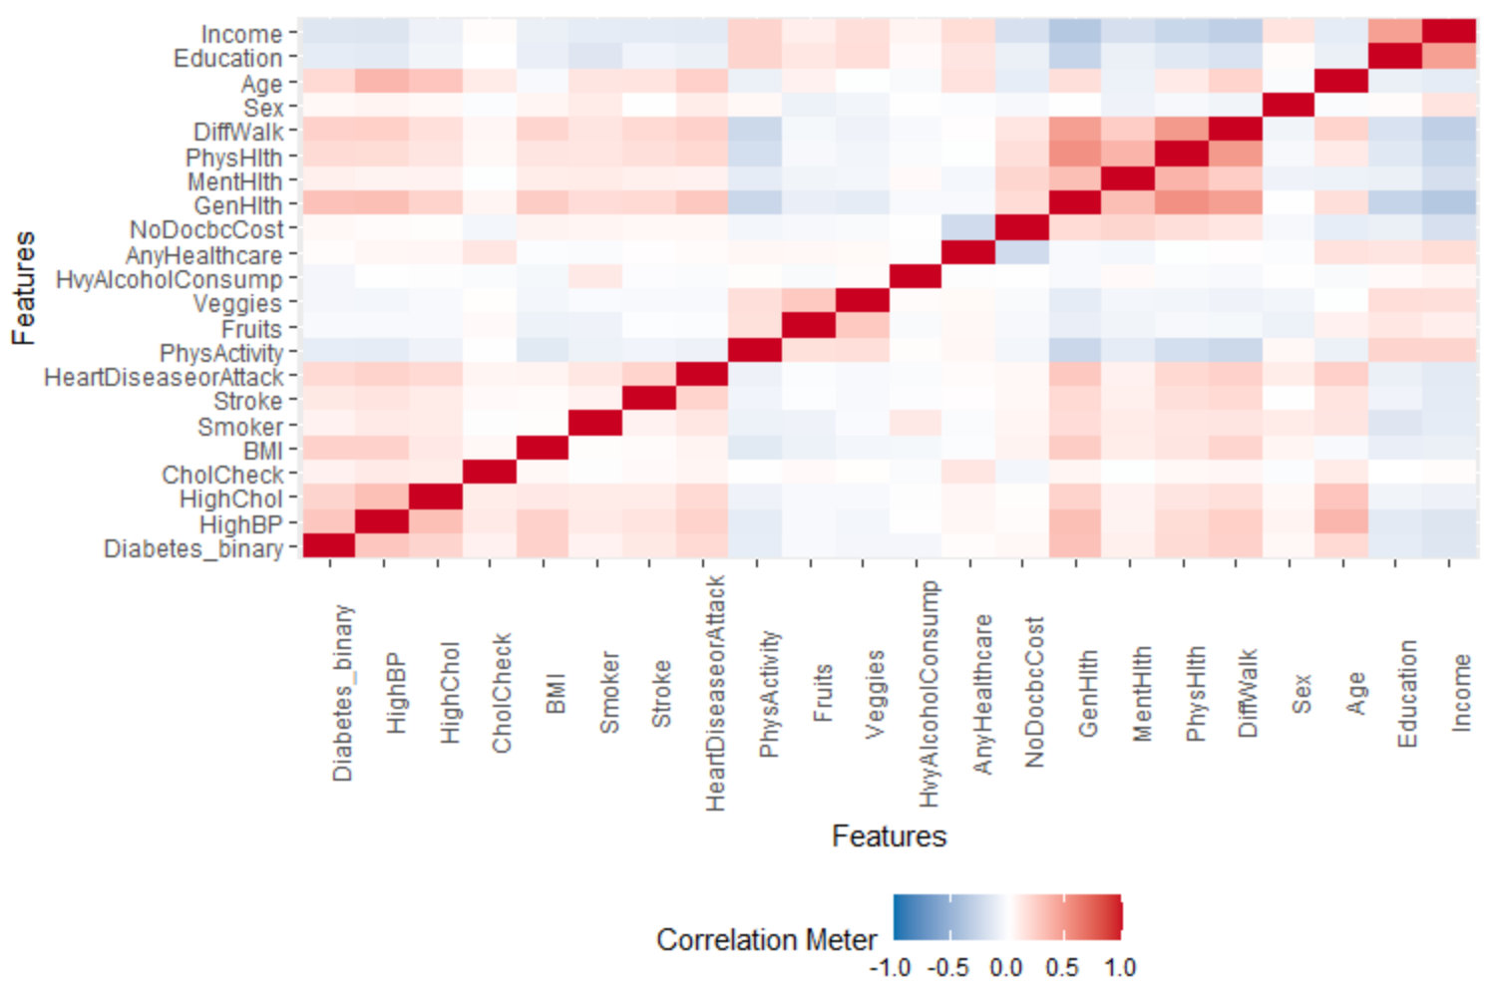
Research Questions
Question 1: What risk factors are most predictive of diabetes risk?

Slide 6
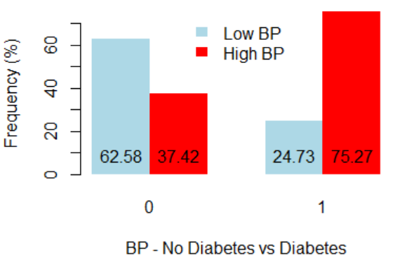
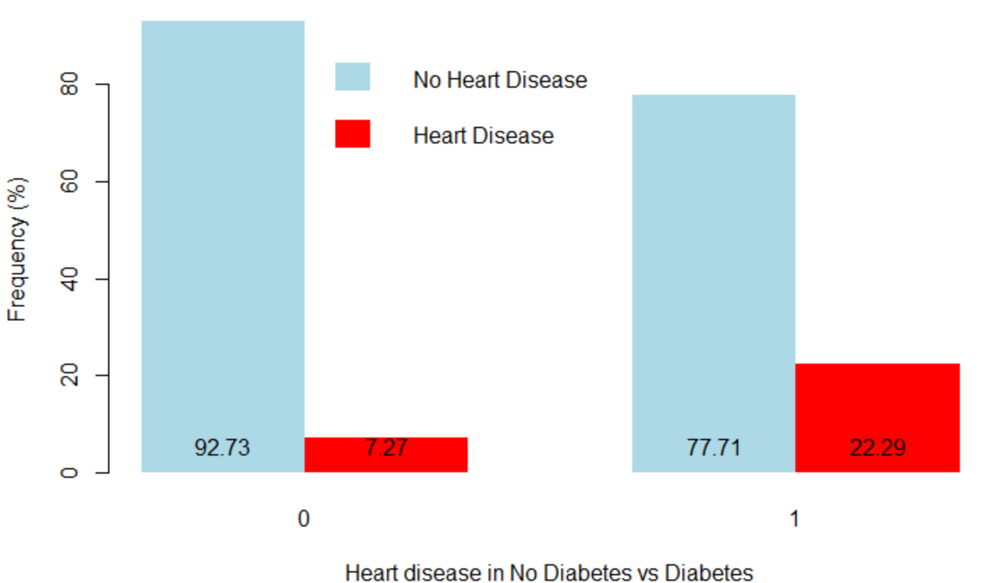
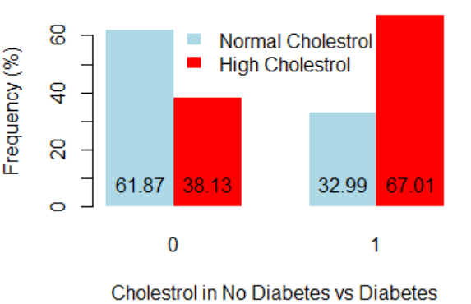
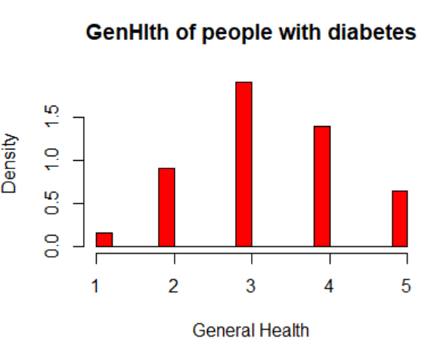
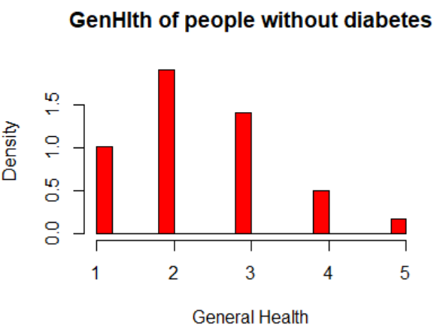
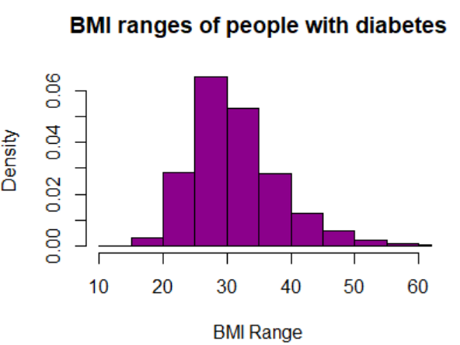
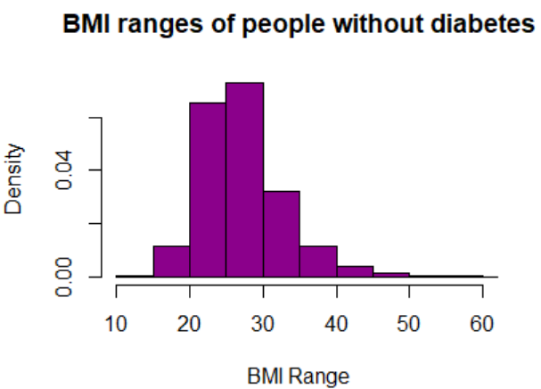
Research Questions
Question 1: What risk factors are most predictive of diabetes risk?

Slide 7
Research Questions
Question 2: How accurately can we predict if the patient has diabetes or not?

Slide 8
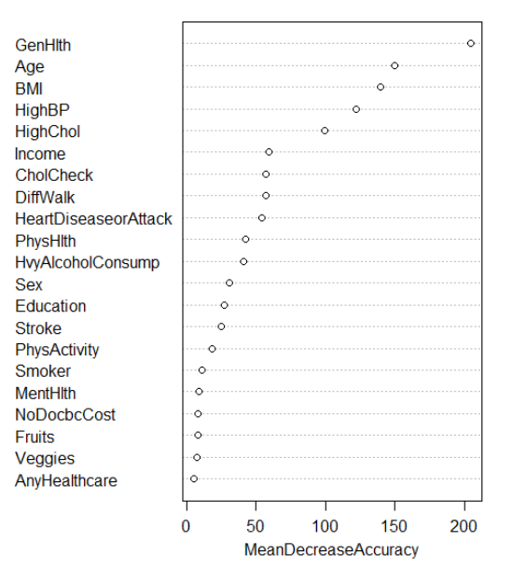
Research Questions
Question 3: Can we use a subset of the risk factors to accurately predict whether an individual has diabetes?

Slide 9
Research Questions
Question 3: Can we use a subset of the risk factors to accurately predict whether an individual has diabetes?

Slide 10
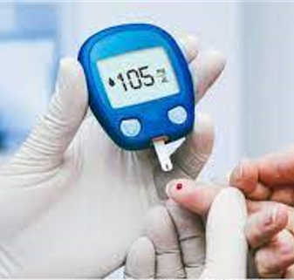
Findings for the Research Question
Variables like BMI, Age, General Health, Blood Pressure, Cholesterol Level appear to play an important role in finding if a person is diabetic or not.
There does not seem to be relationship between parameters like- fruits, veggies, anyHealthCare and diabetes.
People with High cholesterol, High BP, bad General health, high BMI and people in age group between 55 to 69 are more likely to be diabetic.

Slide 11
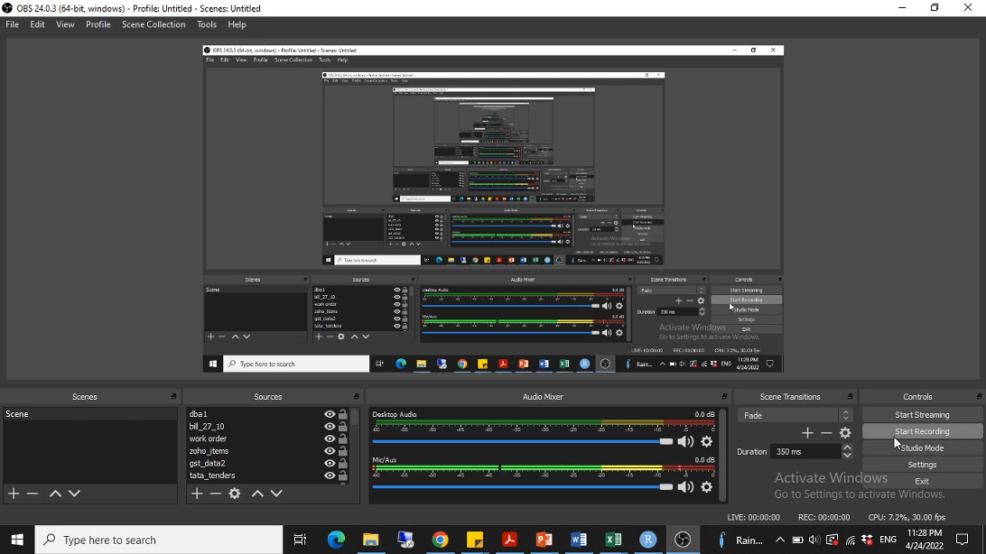
User Interface for diabetes prediction using R Shiny

Slide 12
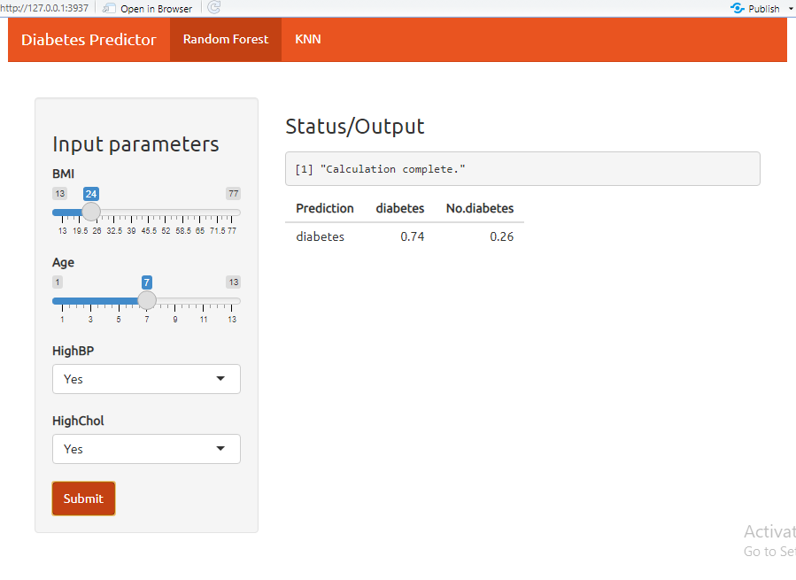

Slide 13
Further Improvements
Adding more models to the user interface using R Shiny
Implement models like XGBoost to check for better accuracy
Implement classification models to check various stages of diabetes.

Slide 14
Questions?

